Slide 1
Features I: Detecting Interest Points
D E P A R T M E N T O F C O M P U T E R S C I E N C E U N I V E R S I T Y O F C O P E N H A G E N
Kim Steenstrup Pedersen
Notes:
Forelæsning: 25 personer (2013)
25 (2014)

Slide 2
Plan for today and next couple of lectures
We consider the problem of matching two or more images
Today we focus on detecting good locations to match.
Next week we focus on how to perform the actual matching.
Relevant for
3D reconstruction
Content-based image retrieval
Object detection and recognition
Tracking

Slide 3
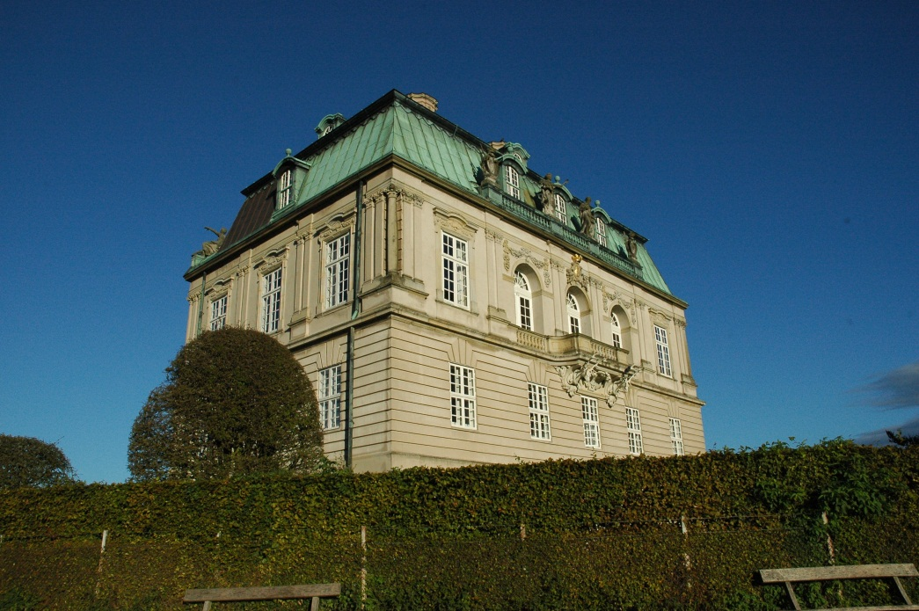
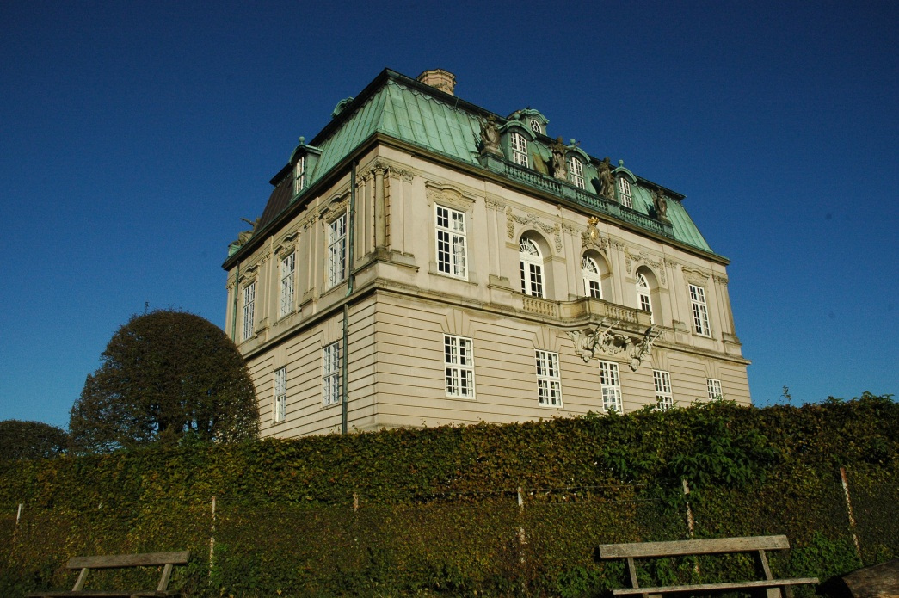
Fundamental Question: Where did the underlying feature go?
?
Matching: Ideally, we want to find the location in the other image which corresponds to the same physical location on the building
Notes:
Two different views of the same building
Ideally we would like to find the location in the other image that corresponds to the same physical location on the building.

Slide 4
Matching Strategy Illustrated
Notes:
Find potential matches – in principal we can have several candidates

Slide 5
Not all image patches can be matched
?
To be able to figure out which points belongs to which we need a bit of structure:
Sky patches are impossible to match Curves are also problematic
Notes:
We can match distinct point structures, but curves are not trivial to match.
Make a drawing of two curves and explain the problem.

Slide 6
Dense versus sparse matching?
Dense : Match all pixels in the images
Sparse: Match a subset of positions in the images Both approaches have merit, but dense is computationally expensive
Notes:
Since not all locations are easily matched why not try to find good points to match?
Lets consider the sparse approach

Slide 7
Regular grid vs random points vs salient points
Notes:
Since not all locations are easily matched why not try to find good points to match?

Slide 8
Regular grid vs random points vs salient points
Notes:
Sparse set of points but a lot out in structure-less regions (Sky)
But might be relevant for object detection
And there is no guarantee we have points in both images on the same physical location.

Slide 9
Regular grid vs random points vs salient points
Notes:
Same problem – high chance of hitting structure-less points (a lot of sky points)!
Also useless when it comes to matching for 3D reconstruction: We would like points appearing on the same 3D location in both images.

Slide 10
Regular grid vs random points vs salient points
Notes:
Since not all locations are easily matched why not try to find good points to match?
Multi-scale Harris corner detector with localization: Approximately 600 points in each image
Ok, there are still points we do not find in both images, but there are still many for which we do.

Slide 11
Salient points = Interests points
Salient points: Local structure that appear distinct from the image in the surrounding region of the salient point.
We need an operational definition in order to detect such points!
Terminology: Salient points aka interest points aka keypoints aka features (old confusing terminology)

Slide 12
How to automatically detect interesting points?

Slide 13
Detecting points by template matching
Template
?
How do we construct a generic corner template?
Bad idea – won’t work!
Notes:
Template must be robust to changes in view point, scale and illumination.
Extremely difficult! Especially on images with persepective distortion
I deliberately won’t tell you how to do this ☺

Slide 14
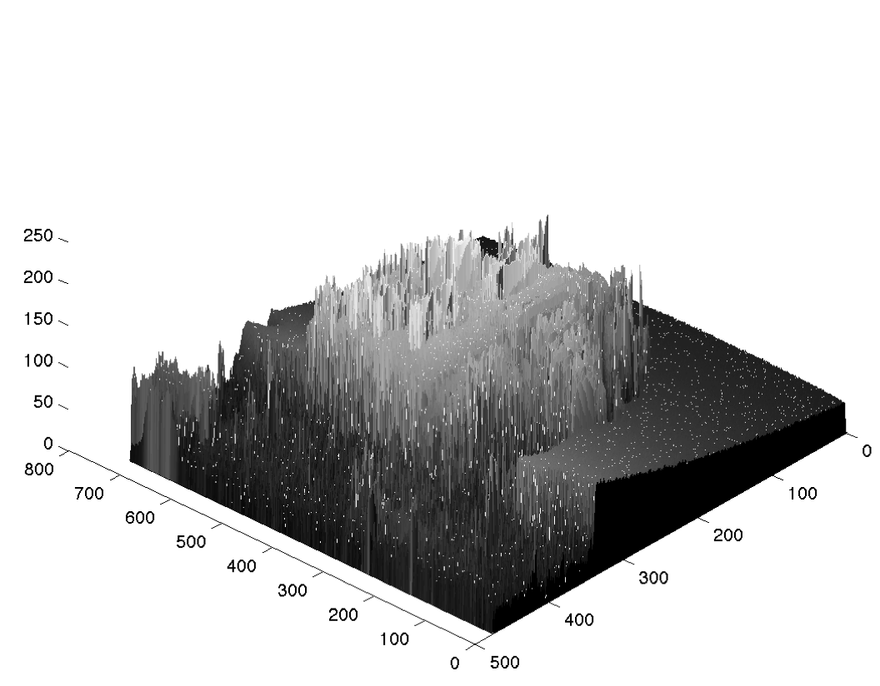
Viewing images as functions
Notes:
Recall from last lecture: We can think of an image as a function of two variables (x,y).
In the following we will switch to gray scale images.
The geometry we are looking for does not depend on color.
Lets try to find salient points in this function

Slide 15
Interest point detectors: Detecting blobs
Local intensity extrema (maxima and minima) are potential candidates for salient points.
Extrema are distinct from the neighboring pixels.
We refer to these extrema as bright or dark blobs.
How do we find intensity extrema?
Compute image derivatives
Notes:
Local hills or holes in the intensity landscape. We do not really care about global extrema

Slide 16
Linear Filtering 101
Filtering by discrete convolution
A filter is defined by a filter kernel h(x,y)
Filtering the image I(x,y) with the kernel h(x,y) is defined as
Consider filter kernels as images
They do not have to be of the same size as the image
Filtering slides the reverse filter kernel across the image and compute the product sum at each location
The result at (x,y) is called the filter response
R is an image of same size as the original image I.
Notes:
We need to compute image derivatives and we use filters to do so
As before I assume that x,y are discrete positions (does not have to be finite).
The sum runs over all non-zero elements in h(x,y)
Make a drawing or use http://en.wikipedia.org/wiki/Convolution#Discrete_convolution
There is much more to filtering and convolution but we will skip that (follow SIP instead).
Next year: Consider adding an illustration of how to compute convolution, but it is not really essential

Slide 17
Gaussian derivative filter kernels
Aside: Neurophysiological experiments by Young (1987) show that the receptive field profiles in the human retina and visual cortex can be modelled by Gaussian derivatives.
Notes:
Recall that we want to be to take derivatives of images!
Sigma we refer to as the scale of the filter – it sets the size of the Gaussian bell curve
I simply drew the filters as images by evaluating the filter function at discrete spatial locations (at the pixels)

Slide 18
Image derivatives with Gaussian filters
Notes:
Now we can compute image derivatives
Notice the type of structure the derivatives pick up – basically contrast changes such as extrema and intensity edges

Slide 19
Interest point detectors: A simple 1D example
Finding extrema - look for points where
Notes:
With this simple signal, we could either pick the places of maximal gradients (1st order derivatives) or the extrema or zero crossings of the signal
Extrema of the signal: Find all zero-crossings of the gradient or even better use the 2nd order derivatives and find extrema of these.

Slide 20
The gradient vector field

Slide 21
Interest point detectors: Detecting blobs by Laplacian of Gaussian filter
Finding extrema in 2D:
Find points that are simultaneous extrema in the x and y direction.
We can solve this in one go by looking for extrema of the Laplacian of Gaussian filter
Bright blob: Dark blob:
Discrete implementation: Extrema search in 2D
Bright blob: than all neighbor pixels
Dark blob: than all neighbor pixels
4-neighbors or 8-neighbors
Keep only blobs where threshold value
Notes:
In principal we should look for points of zero gradient – these are all candidate points
The Laplacian (2nd order derivatives) tell us if it is a local maxima or minima.
By looking for local extrema of the Laplacian we are reducing further the amount of detected points.
Next year: Stress that the + in the Laplacian is pixelwise – matrix addition (they are not confident with matrices).

Slide 22
Interest point detectors: Detecting blobs
Notes:
Yellow: Dark blobs
Red: Bright blobs
Scale = 4
It also trickers on edges and other stuff

Slide 23
Detecting blobs by Laplacian of Gaussian filter: Pitfalls
Notes:
Notice: the 2nd order derivative extrema (green curve) is not located at an extrema of f(x)!
Lesson learnt: Some of the detected blobs are not really local extrema of the image. But it might be good enough for our purposes

Slide 24
The gradient vector field

Slide 25
Interest point detectors: Detecting corners with Harris corner detector
Harris corners are defined as points of local maxima of the Harris corner measure:
Where
It encode gradient information under the window G.
R obtain maxima at intensity corners, but also for other structures.
This version is referred to as the improved or fixed scale Harris corner detector.
Notes:
Corners formed by iso-intensity curves.
Alpha is a constant that needs to be fixed, alpha=0.06
A is related to the autocorrelation function and is also sometimes referred to as the structure tensor.
Gaussian window. A matrix per pixel in the image
Next year: Give an intuitive explanation of why Harris detects corners.

Slide 26
The gradient vector field
Notes:
There is a mistake in the sign on the L_y value in this illustration!

Slide 27
Interest point detectors: Detecting Harris corners (fixed scale)

Slide 28
Multi-Scale analysis
An Introduction to Scale Space Theory

Slide 29
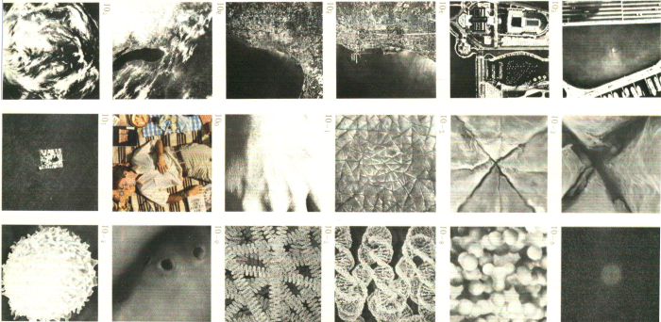
Measurements What do we measure?
Slide by Arjan Kuijper, 2003
Notes:
From outer space to atoms

Slide 30
Observations
Objects have a size / scale (both real and apparent)
Objects consists of objects of various sizes.
They contain several scales.
Objects are measured by some device.
Cameras, the eye, …
Devices are finite.
They have a minimum and a maximum detection range: the inner and outer scale. They determine the spatial resolution.
The device must allow multi-scale structures.
It has to respect the various sizes of the object. The inner scale isn’t always the best scale to perform analysis.
Slide by Arjan Kuijper, 2003

Slide 31
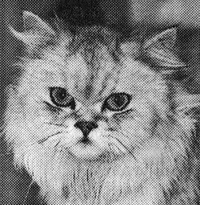

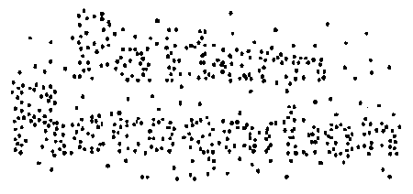
The visual system
We see multi-scale:
These images only contain two values (black and white).
We regard them as grey level images, or see structure.
Slide by Arjan Kuijper, 2003
Notes:
Dithering effect on the cats image and the text

Slide 32
The visual system (Founding fathers of scale space theory)
Jan J. Koenderink
Taizo Iijima
Slide by Arjan Kuijper, 2003
Notes:
Another example:
Images of Iijima have their average intensity level rescaled with the intensity of the local image patch in Koenderinks image.
We can interpret this image at fine scales and see Iijima or at large scales and see Koenderink

Slide 33
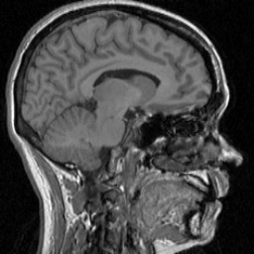



To model (II)
Don’t trust the resolution.
What does a detector of a 3 pixels circular size detect?
Slide by Arjan Kuijper, 2003
Notes:
Here we see the same object at different resolutions.
It is the same object but it appear differently.
How do we become robust to this effect?
Answer: Do processing at multiple scales to achieve scale invariance

Slide 34
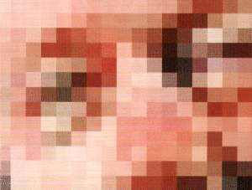
To model (III)
Don’t trust the grid.
Slide by Arjan Kuijper, 2003
Notes:
Move the object slightly in front of the camera and the image changes drastically at grid scale

Slide 35
To model a device
It has finite resolution.
Infinite resolution is impossible.
Take uncommitted observations
There is no bias, no knowledge, no memory.
We know nothing.
At least, at the first stage. Refine later on.
Allow different scales.
There’s more than just pixels .
View them simultaneously.
There is no preferred size.
Noise is part of the measurement.
Beware!
Slide by Arjan Kuijper, 2003
Notes:
Next year: Consider dropping this slide

Slide 36
Deep structure
The challenge is to understand the image really on all the levels simultaneously, and not as an unrelated set of derived images at different levels of blurring.
Jan Koenderink (1984)

Slide 37
Our choice of model: Linear scale space
The scale space of I is a 1-parameter family
Scale is given by
As the scale increases details in the image disappear and we focus on the large scale structures that are left.
Notes:
At scale sigma=0 we have the original image
Next year: Try to make a 3D illustration of the scale space

Slide 38
Multi-scale versus multi-resolution: The Gaussian pyramid
Notes:
This is simply an implementation of scale space taking advantage of the reduction in detail
Next year: Consider adding a bit more details here: E.g. subsample by taking every second pixels after Gaussian blurring.

Slide 39
Multi-scale versus multi-resolution: The Gaussian pyramid
A typical pyramid representation may involve 3-10 pyramid levels obtained by successive Gaussian low-pass-filtering and sub-sampling with a reduction factor of 2.
In pseudo-code for image J:
First pyramid level is given by J₀ = J
Pyramid level L is given by J_{L} = reduce(J_{L-1} * G)
Where reduce() down-samples the image by a factor of two by considering a block of 2 x 2 pixels and reducing them to 1 pixel, e.g. pick one value out of the 2 x 2 pixels.

Slide 40
Multi-scale versus multi-resolution: The Gaussian pyramid
Notes:
This is simply an implementation of scale space taking advantage of the reduction in detail
Next year: Consider adding a bit more details here: E.g. subsample by taking every second pixels after Gaussian blurring.

Slide 41
Multi-scale interest point detection

Slide 42
Interest point detectors: Detecting blobs by Difference of Gaussians (DoG)
Difference of Gaussians (DoG) is an approximation to the Laplacian of Gaussian filter
Either subtract Gaussian filters prior to filtering or subtract filtered images.
As before look for extrema in
In a multi-scale setting compute the scale space images with factor k increase in scale and search for extrema in scale space. Can be combined with a Gaussian pyramid for increased processing speed.
Notes:
k is a scaling factor

Slide 43
Summary
Matching salient points
Filtering 101
Interest point detection
Blobs (DoG, Laplacian)
Corners (Harris corners)
Scale invariance: We need to consider structure at multiple scales (Scale space theory)

Slide 44
Literature
Reading material:
Forsyth and Ponce: Ch. 7.1 – 7.2, 7.7 (Filtering basics)
Lowe IJCV 2004, Sec. 1 – 3 (DoG, Laplacian)
Schmid, Mohr and Bauckhage IJCV 2000, Sec. 1 – 2 (Harris corner)
Lindeberg 1996 (Scale-space theory)
Additional material:
C. Harris and M. Stephens: A Combined Corner and Edge Detector. 4th Alvey Vision Conference, 147—151, 1988.
Notes:
Next year: The Lindeberg paper I think is overkill for them – convert it to additional material

Slide 45
Mandatory assignment 1: Feature extraction
Build and experiment with interest point detectors
Find matching points between two images
Notes:
Start by installing software and make this run before Wednesday
from PIL import Image
From numpy import *
from scipy.ndimage import filters
help(filters.gaussian_filter)
Im=array(Image.open(‘myimage.jpg’).convert(‘L’))
Im2 =filters.gaussian_filter(im, 5)

Slide 46
Lets have a break and then you work with the assignment

Slide 48
Salient Keypoints Matching Strategy
For a pair of images:
Extract salient keypoints, via detectors e.g. Harris corners, DoG (blobs), MSER
Compute Feature descriptors, eg. Raw patch (correlation), SIFT, DAISY
Match features by pairing similar descriptors
Aggregate solution to multiple images if needed.
Notes:
More about this next week.
Next year: This can be skipped

Slide 49
TODO: Multi-scale Harris and multi-scale blobs?
Or move to next lecture?
Next year: You can easily cover this during this lecture and it would fit nicely after DoG or before.

